Slide 1
D-Risk
BY TEAM INFERNO

Slide 2
What is Risk?
Risk is a turn-based board game, in which 2 to 6 players fight over the given territories in a political map
3 Phases: Deploy | Attack/Fortify | Execute
The player who occupies all the territories first wins.

Slide 3
Demo

Slide 4
SCORE Requirements
Develop a turn based client server Risk game.
Implement all core functionalities
Different complexity levels
Small
Medium
Hard
The game must come with at least one preloaded map.
3 documents
Requirement Document
Design Document
User Manual

Slide 5
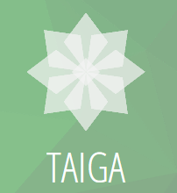


Agile methodology

Slide 6
Agile methodology
“Allow for change”
“User stories are placeholders for conversation”

Slide 7
Agile methodology
Sprint 1 (Sep 21 – Oct 5)
Sprint 4(Nov 3 – Nov 16)
Sprint 3 (Oct 20 – Nov 2)
Sprint 2 (Oct 6 – Oct 19)
Stabilization sprint

Slide 8
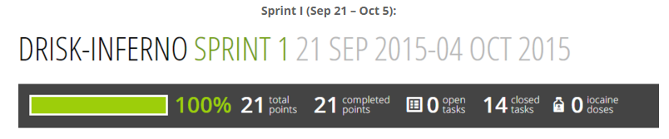
Agile methodology
Sprint One
Crucial phase
Making ourselves familiar with the game.
Gather data and tools required for the development of the product.
Learning new technologies.

Slide 9
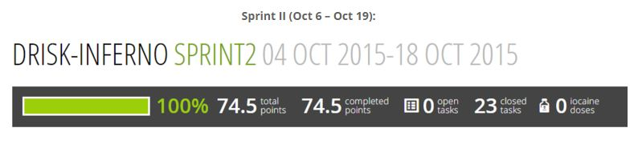
Agile methodology
Sprint Two
Divided the work into phases.
Generation of map using Adobe illustrator tool.
Working on the UI part viz. the login/sing up, create/join game page.
Maintaining google site and preparing mid-term presentation.

Slide 10
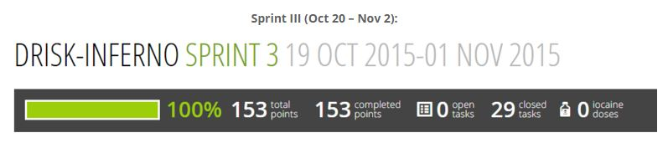
Agile methodology
Sprint Three
Focused on developing the game with 2 player scenario.
Developed the functionalities for deploy, attack and execute.
Worked on the server side as well.
Discussion for extending it to 6 players and 2 more configuration of maps

Slide 11
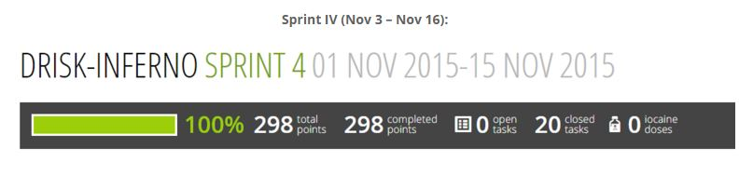
Agile methodology
Sprint Four
Generated the map for easy and medium configuration.
Extending the functionalities for 6 players.

Slide 12
Q&A

